Slide 1


Analysis of algorithmic efficiency: Asymptotic notations and their properties Session No.: 1 Course Name: Design and analysis of algorithms Course Code: R1UC302B Instructor Name: Mr. Pradeep Chauhan Duration: 40 min Date of Conduction of Class: 28/02/2025

Slide 2
RECAP: An algorithm is a sequence of unambiguous instructions for solving a problem, i.e., for obtaining a required output for any legitimate input in a finite amount of time.

Slide 3



A Small Activity
G1: Write an algorithm to prepare Maggie. G2:Write an algorithm to prepare Tea. G3: Write an algorithm to prepare a chapati.

Slide 4
Ask Questions
Can you compare the time taken by the 3 algorithms that you have written?
How are you able to compare the time.
Discuss among your table members.

Slide 5
At the end of this session students will be able to
Learning Outcome 1:Comprehend different asymptotic notations.
Learning Outcome 2 : Analyse the time complexity of simple algorithms using Big-O, Omega, and Theta notations.

Slide 6
Session Outline
1 Introduction
2
3
4
5
6
Learning activity 1
Concept and Definition for Learning Activity 2
Learning Activity 2
Properties of Asymptotic Notations
Problem Solving and Hands-On Practice

Slide 7
Introduction to algorithmic analysis
Algorithm Efficiency
Algorithm efficiency refers to how well an algorithm performs in terms of time and space complexity as the input size increases.
Types of Algorithm Efficiency
Time Complexity – Measures how the execution time of an algorithm grows with input size.
Space Complexity – Measures the amount of memory used by an algorithm during execution.

Slide 8
Learning Activity-1(10 minutes)Think Pair share
a. for(int i=1;i<100;i++)
{
Systm.out.println(“hello”);
}
b. for(int i = 0; i < n; i++)
{
for(int j = 0; j < n; j++)
{
cout << i << " " << j;
}
}
What are the time complexity of the given codes?

Slide 9
Reflection- Learning Activity 1
Q1. What is main difference between these two codes?

Slide 10
Asymptotic Notations
The main idea is to have a measure of effeciency of algorithms that doesn’t depend on machines.
Ides is measuring order of growth.
There are mainly three asymptotic notations: Big-O Notation (O-notation) Omega Notation (Ω-notation) Theta Notation (Θ-notation)

Slide 11
Big-O Notation (O-notation):
Big-O notation represents the upper bound of the running time of an algorithm.
It is the most widely used notation for Asymptotic analysis.
If f(n) describes the running time of an algorithm, f(n) is O(g(n)) if there exist a positive constant C and n0 such that, 0 ≤ f(n) ≤ cg(n) for all n ≥ n0

Slide 12
Omega Notation (Ω-Notation):
Omega notation represents the lower bound of the running time of an algorithm.
Let g and f be the function from the set of natural numbers to itself. The function f is said to be Ω(g), if there is a constant c > 0 and a natural number n0 such that c*g(n) ≤ f(n) for all n ≥ n0

Slide 13
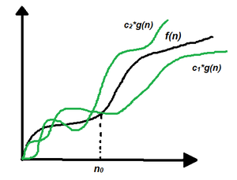
Theta Notation (Θ-Notation):
Theta notation represents the upper and the lower bound of the running time of an algorithm.
Let g and f be the function from the set of natural numbers to itself. The function f is said to be Θ(g), if there are constants c1, c2 > 0 and a natural number n0 such that c1* g(n) ≤ f(n) ≤ c2 * g(n) for all n ≥ n0

Slide 14
Properties of Asymptotic Notations:
General Properties:
If f(n) is O(g(n)) then a*f(n) Is also O(g(n)), where a is a constant.
Transitive Properties: If f(n) is O(g(n)) and g(n) is O(h(n)) then f(n) = O(h(n))
Reflexive Properties: If f(n) is given then f(n) is O(f(n)). Since MAXIMUM VALUE OF f(n) will be f(n) ITSELF!

Slide 15
Properties of Asymptotic Notations:
Symmetric Properties: If f(n) is Θ(g(n)) then g(n) is Θ(f(n))
Transpose Symmetric Properties: If f(n) is O(g(n)) then g(n) is Ω (f(n))

Slide 16
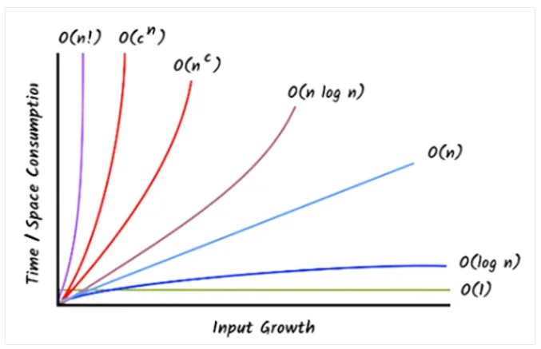
Summary

Slide 17

Learning Activity 2(10 min)(Individual)

Slide 18
Discussion on the post session activities
MCQ based Quiz on this session.

Slide 19
Information about the next lesson
Analysis Framework and Empirical Analysis

Slide 20
Review and Reflection from students
Provide your feedback on analysis of algorithms effeciency session.

